Slide 1
BI PROJECT
Analysis of number of students in school per state
Team Members
Aditi Arora 14UCS005
Aditi Mittal 14UCS006
Vamsi Krishna 14UCS136

Slide 2
Datasets used
No. of boys , girls and total students in Primary and Upper Primary school per state in India from year 2001 - 2010.
No. of boys , girls and total students in Lower Secondary, Secondary and Upper Secondary school per state in India from year 2001 - 2010.
Student to Teacher ratio in Primary and Upper Primary school across different states in India 2001 to 2010.
The above two datasets were combined for analysis.

Slide 3
Preprocessing
Using tidyr and dplyr
Pivoting the number of students data at year because years were needed in a single column
Pivoting the data in the student teacher ratio data set at year.
Primary School Total for India was missing.
Why?
Joining with shapefile data in an optimal manner so that maps are prepared in a faster way.

Slide 4
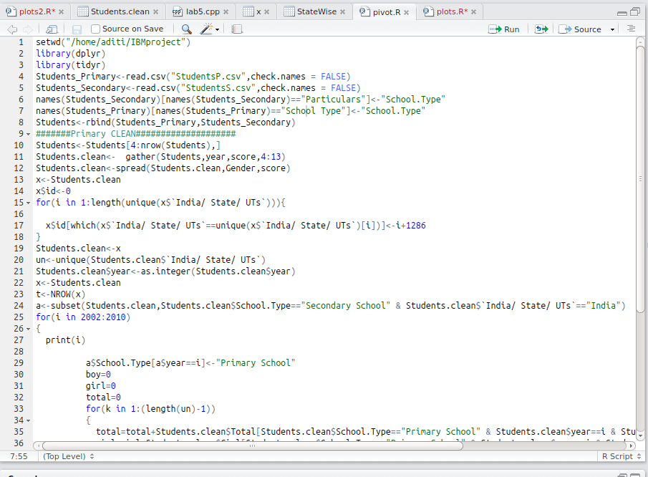

Slide 5
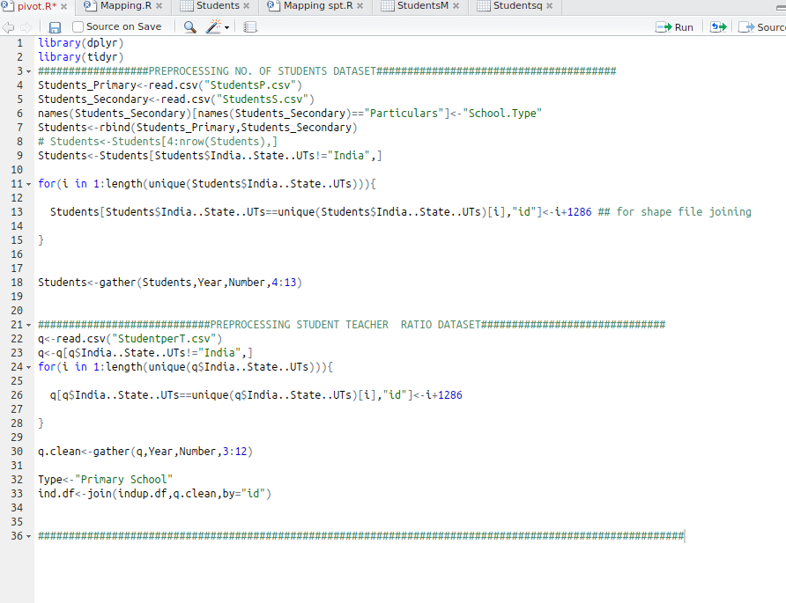
Preprocessing(Maps)

Slide 6
Initial Analysis
Line plot was plotted per state . Different line for each school Type.
Common Trend Observed:
No. of students (Primary School ) >>> No. of students (Secondary School)

Slide 7
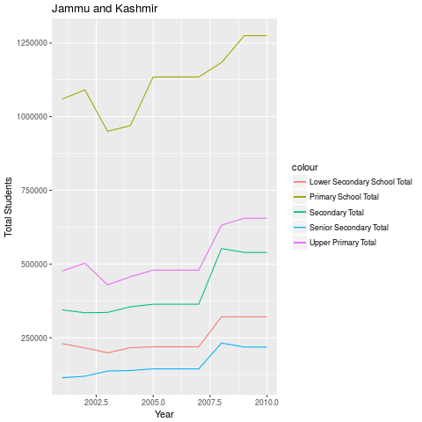
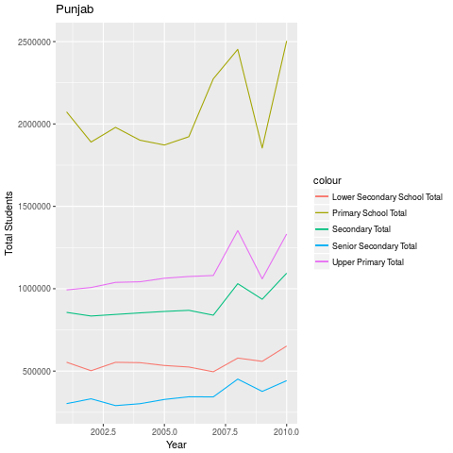
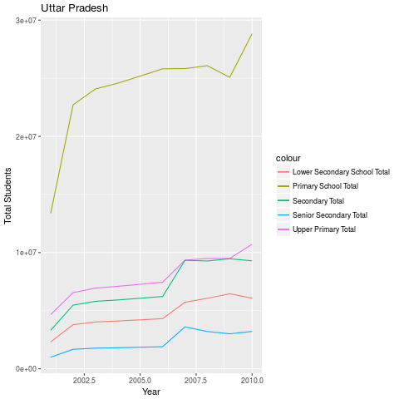
Jammu & Kashmir
Punjab
Uttar Pradesh

Slide 8
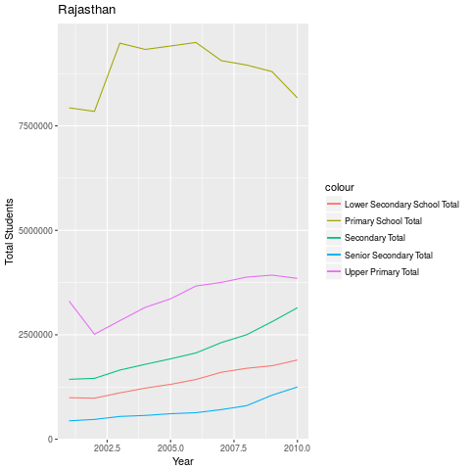
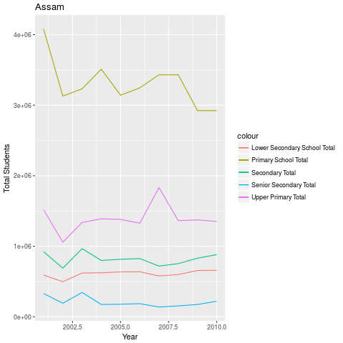
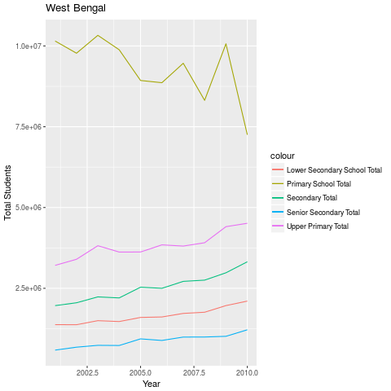
Rajasthan
Assam
West Bengal

Slide 9
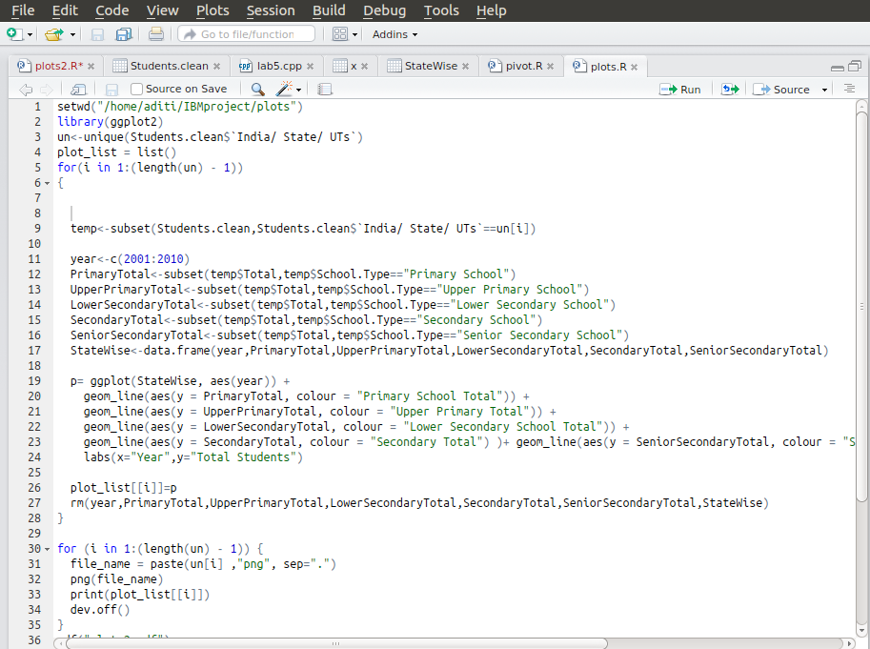
Code Snippet for above plots

Slide 10
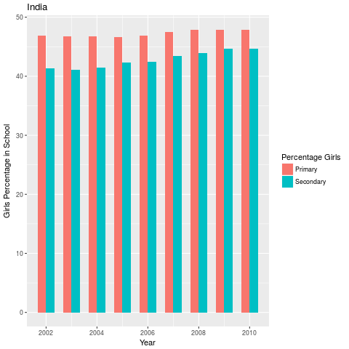
Girl Percentage per state : Primary and secondary school
Percentage of girls in primary school per year
Red colour in graph
46.8255 % in 2002
Increased to 47.923 % in 2010
Percentage of girls in Secondary school per year
Blue colour in graph
41.3032% in 2002
Increased to 44.719% in 2010
Every year , girl percent in Secondary School is less than girl percent in Primary School
State wise analysing this

Slide 11
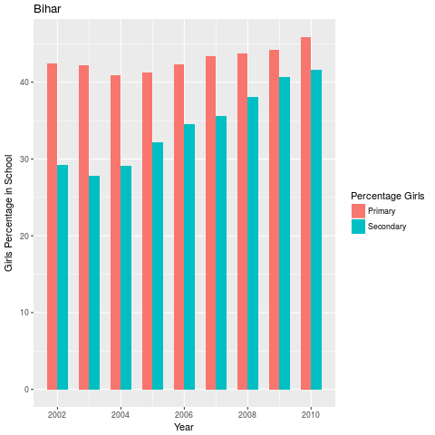
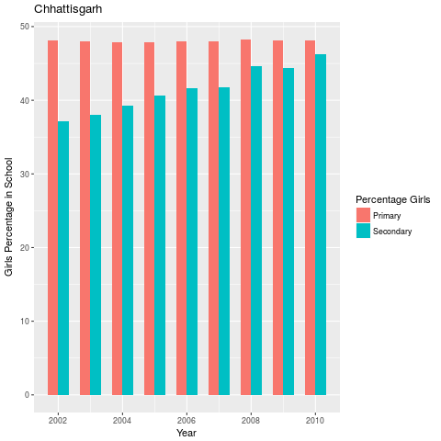
States with significantly low Girl Percentage
Remarkable rise in Secondary girl percentage can be seen in Bihar
2002 - 29.2% (42.48%)
2010 - 41.6% (49.95%)
Still less than primary
Chhattisgarh
2002 - 37.1 %
2010 - 46.22 %
Bihar
Chhattisgarh

Slide 12
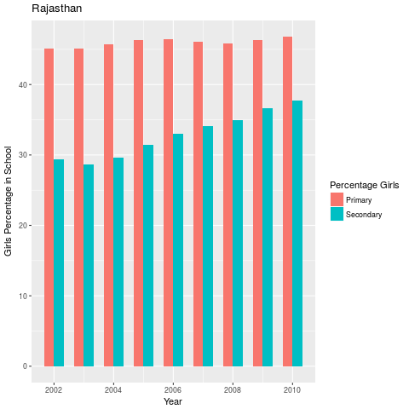
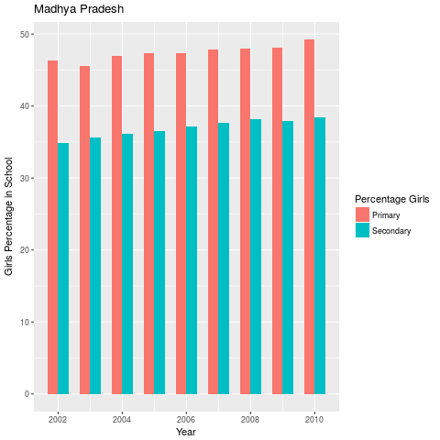
Though the state of Rajasthan has improved in the previous years but the secondary school Girl Percentage is still not good.
2002 - 29.3 % (45.0667 %)
2010 - 46.7 % (37.73%)
Madhya Pradesh
2002 - 34.8% (46.29%)
2010 - 38.47%(49.20 %)
Rajasthan
Madhya Pradesh

Slide 13
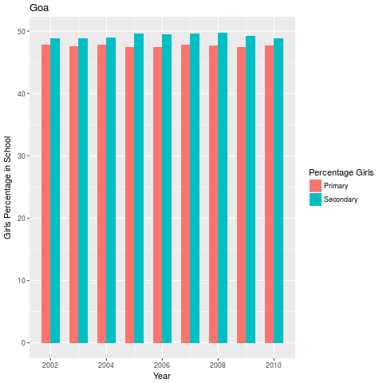
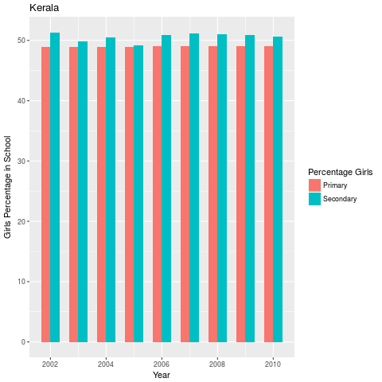
States with Higher Girl Percentage
Both Kerala and Goa have good girl percentage in Secondary and primary school.
Kerala is the only state with more than 50 % girl students in secondary school.
Goa
Kerala

Slide 14
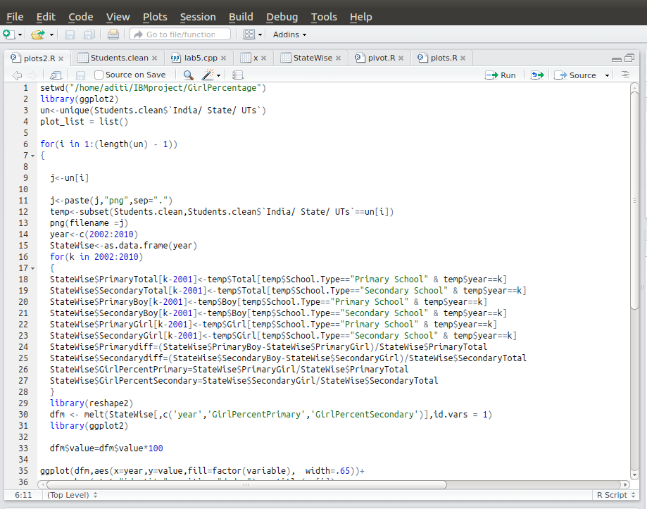
Code Snippet for above plots

Slide 15
Maps and Sex Ratio(Among Students)
This GIF shows the Sex Ratio in Primary Schools across different states in India
Inferences:
Andhra Pradesh and Kerala have been in the correct side over the 10 years.
Uttar Pradesh starts out really low but gradually improves by the end of the decade.
Bihar are again in the wrong side of the spectrum.
Gujarat,Madhya Pradesh and few other states have fluctuating in the middle

Slide 16
Maps and Sex Ratio(Among Students)
This GIF shows the Sex Ratio in Upper Primary Schools across different states in India
Inferences
Rajasthan and Bihar have had the least avg sex ratio over the 10 years.
There was a significant improvement in the sex ratio in Madhya Pradesh and Maharastra
On an average the North-East and South India have a better sex ratio(among students)

Slide 17
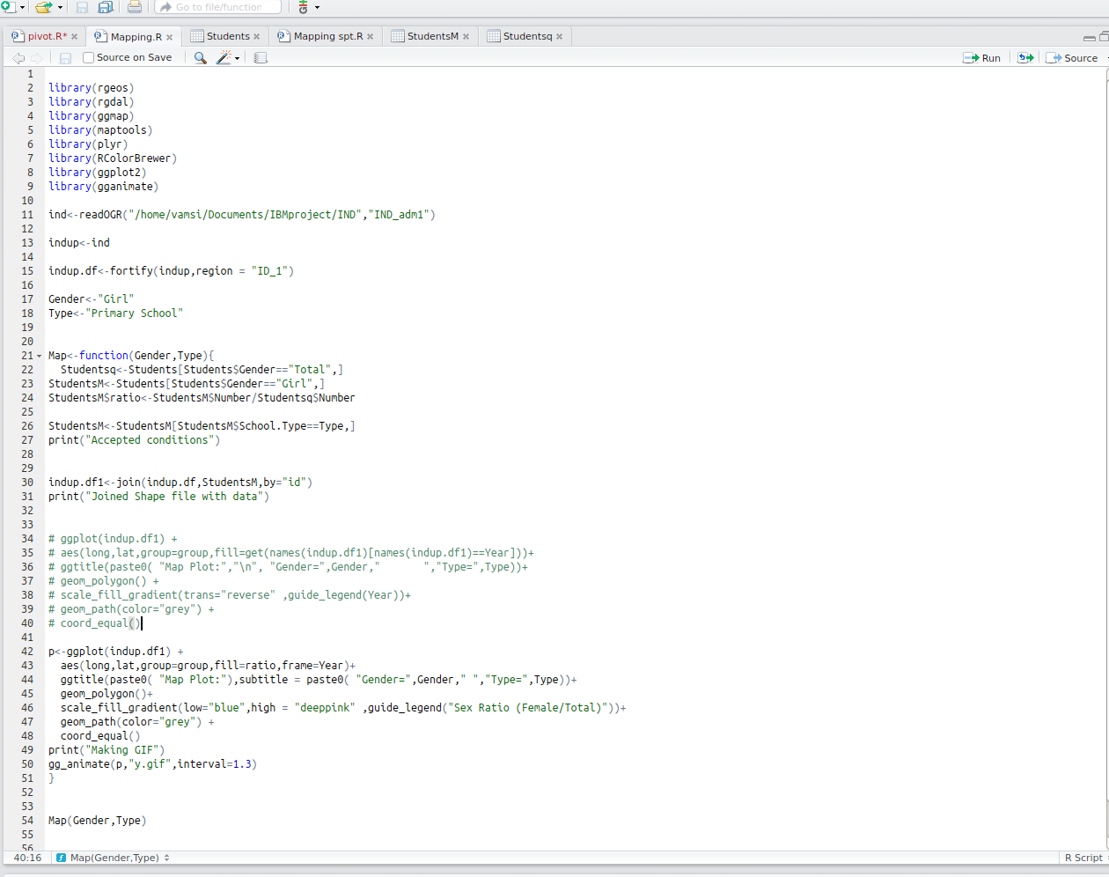
Code Snippet for the above GIFs

Slide 18
Dataset 2 :
Student to Teacher Ratio

Slide 19
Maps,GIFs and More..
The GIF on the left describes the change in Student to Teacher ratio in the primary schools across different states in India across the years 2001 to 2010
The colour scheme is green to red . Red implies ratio is really high(Danger!) and green implies ratio is less (Great!).
Karnataka over the years have been consistently been in the right side whereas Bihar student ratio is at the highest at 2004-2005 but slowly settles down later on.

Slide 20
More..
The GIF on the left describes the change in Student to Teacher ratio in upper primary schools across different states in India across the years 2001 to 2010
Again Bihar in the year 2004-2005 is worse.
Surprisingly enough, Karnataka doesnt fair all that well.What can we infer from this?
Himachal Pradesh and Mizoram have the best rating in both Primary School and Upper Primary School.

Slide 21
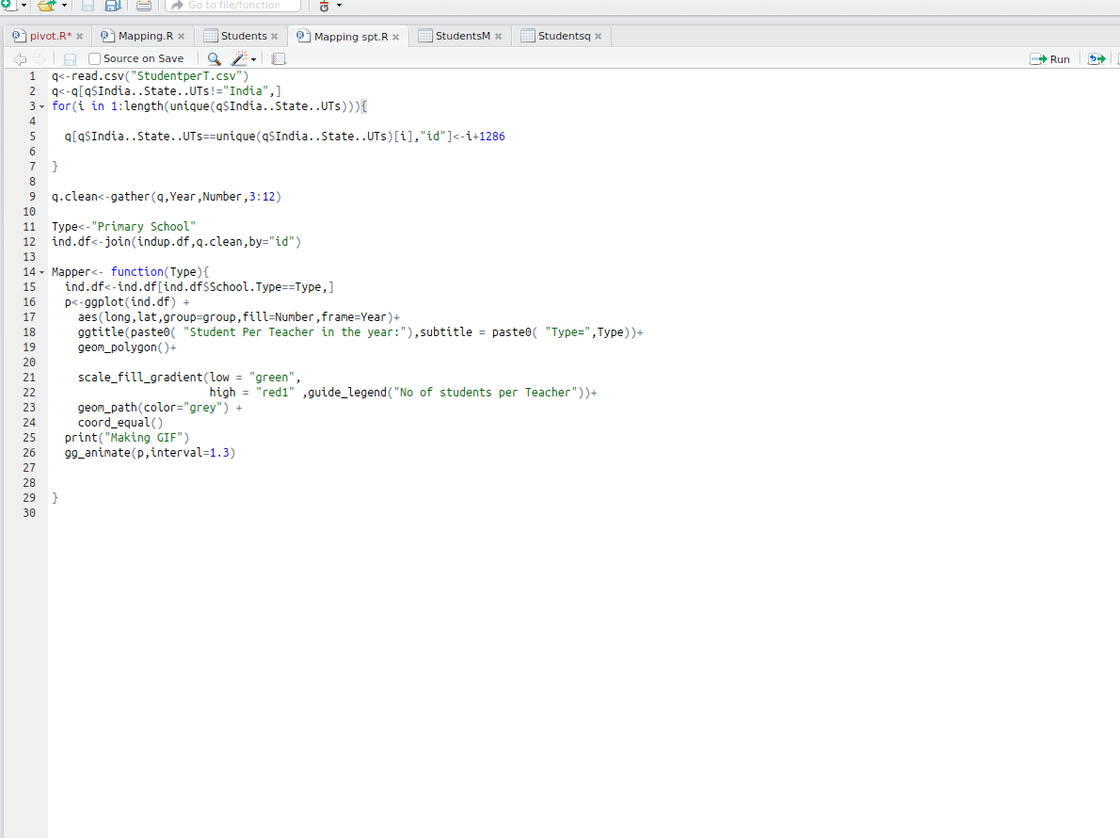
Code Snippet for the above GIFs

Slide 22
Packages Used
tidyr,dplyr,reshape2(Data Manipulation )
rgeos,rgdal(Shapefile utilities)
ggmap,maptools(Maps )
ggplot2(Visualizations)
gganimate(Create dynamic GIFs)
RcolorBrewer(Colour schemas)

Slide 23
Additional Links
Shapefile Data<- ”https://github.com/vamsikrishna97/IBMproject/tree/master/IND”
Data<- ”https://data.gov.in/catalog/number-students”
Mapping Code<- ”https://github.com/vamsikrishna97/IBMproject”

